Slide 1
Network DEA in Insurance Industry
吳延東

Slide 2
Network DEA model(according to Hwang and Kao 2008)
Revised network DEA model
Multi-output network DEA model in Non-life Insurance Industry
資料取得
資料視覺化

Slide 3
Network DEA model(according to Hwang and Kao 2008)
Revised network DEA model
Multi-output network DEA model in Non-life Insurance Industry
資料取得
資料視覺化

Slide 4
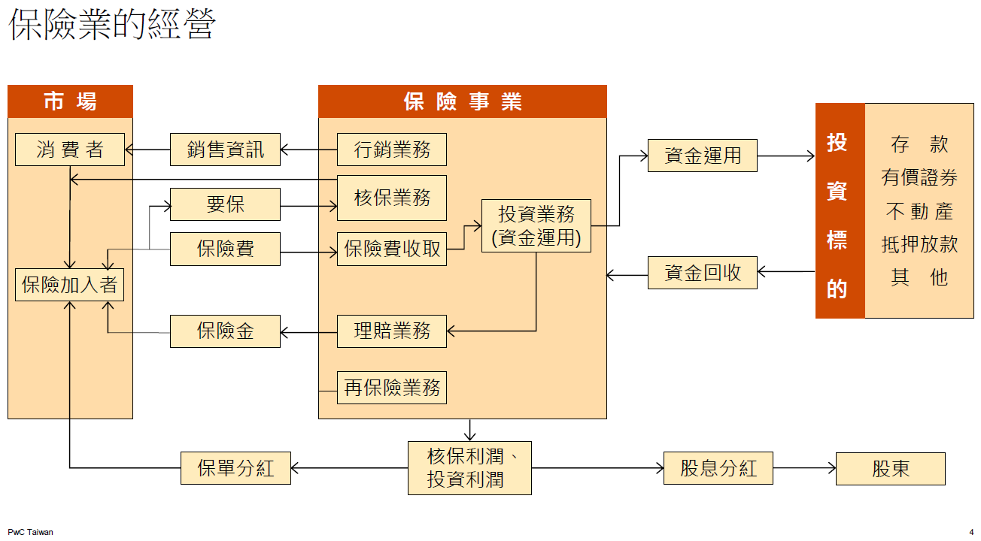
Network DEA in Insurance Industry

Slide 5
Network DEA in Insurance Industry

Slide 6

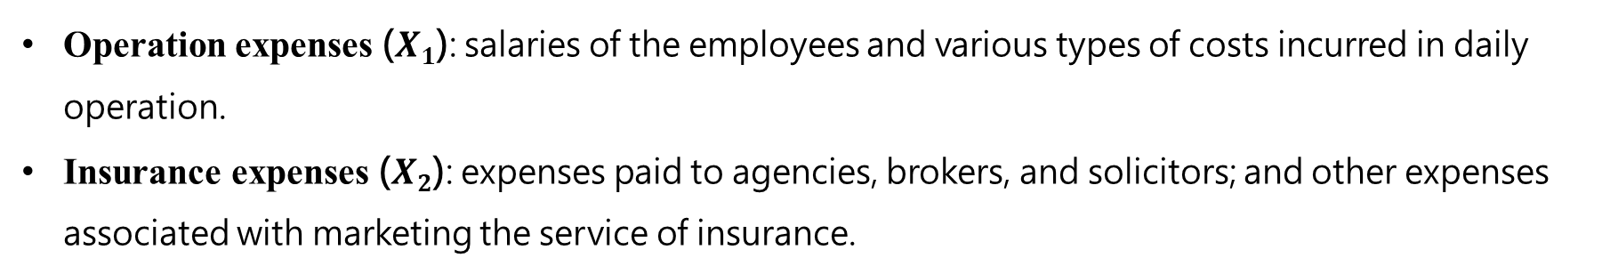
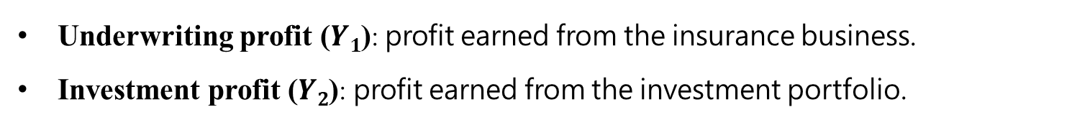
Network DEA model (according to Hwang and Kao 2008)
Network DEA in Insurance Industry
Operation expenses ($X1$): salaries of the employees and various types of costs incurred in daily operation.
Insurance expenses ($X2$): expenses paid to agencies, brokers, and solicitors; and other expenses associated with marketing the service of insurance.
Direct written premiums ($Z1$): premiums received from insured clients.
Reinsurance premiums ($Z2$): premiums received from ceding companies.
Underwriting profit ($Y1$): profit earned from the insurance business.
Investment profit ($Y2$): profit earned from the investment portfolio.

Slide 7
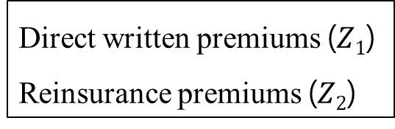
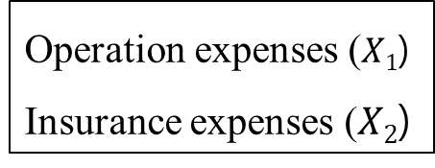
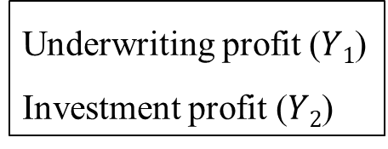
Network DEA model (according to Hwang and Kao 2008)
Network DEA in Insurance Industry
premium acquisition
profit generation
Operation expenses ($X1$)
Insurance expenses ($X2$)
Direct written premiums ($Z1$)
Reinsurance premiums ($Z2$)
Underwriting profit ($Y1$)
Investment profit ($Y2$)

Slide 8
Network DEA in Insurance Industry
premium acquisition
profit generation

Slide 9
Network DEA model(according to Hwang and Kao 2008)
Revised network DEA model
Multi-output network DEA model in Non-life Insurance Industry
資料取得
資料視覺化

Slide 10


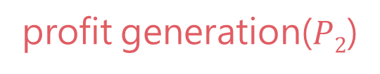


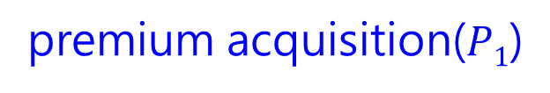
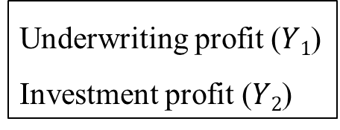

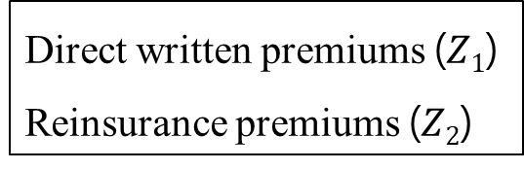

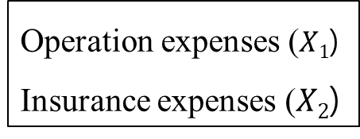


Network DEA model (according to Hwang and Kao 2008)
Network DEA in Insurance Industry
premium acquisition($P1$)
profit generation($P2$)
Operation expenses ($X1$)
Insurance expenses ($X2$)
Direct written premiums ($Z1$)
Reinsurance premiums ($Z2$)
Underwriting profit ($Y1$)
Investment profit ($Y2$)
$$X1$$
$$Z1$$
$$Y1$$
$$P1$$
$$P2$$
$$X2$$
$$Z2$$
$$Y2$$

Slide 11
Network DEA in Insurance Industry
保險業務會影響再保分保業務

Slide 12
Network DEA in Insurance Industry
保險業務會影響再保分保業務
理賠與投資同時進行

Slide 13



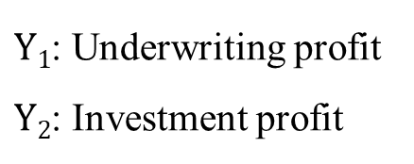



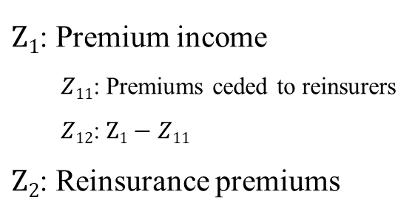



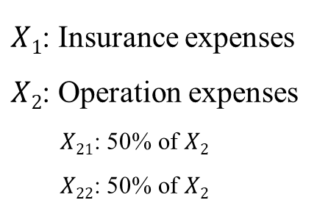


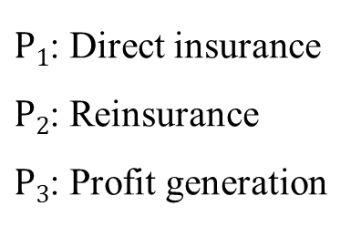


Revised network DEA model
Network DEA in Insurance Industry
Notations:
$X1$: Insurance expenses
$X2$: Operation expenses
$X21$: 50% of $X2$
$X22$: 50% of $X2$
$Z1$: Premium income
$Z11$: Premiums ceded to reinsurers
$Z12$: $Z1−Z11$
$Z2$: Reinsurance premiums
$P1$: Direct insurance
$P2$: Reinsurance
$P3$: Profit generation
$Y1$: Underwriting profit
$Y2$: Investment profit
$$X1$$
$$P1$$
$$Z1$$
$$Y1$$
$$Z12$$
$$X21$$
$$P3$$
$$Z11$$
$$X2$$
$$P2$$
$$Z2$$
$$Y2$$
$$X22$$

Slide 14
Network DEA model(according to Hwang and Kao 2008)
Revised network DEA model
Multi-output network DEA model in Non-life Insurance Industry
資料取得
資料視覺化

Slide 15

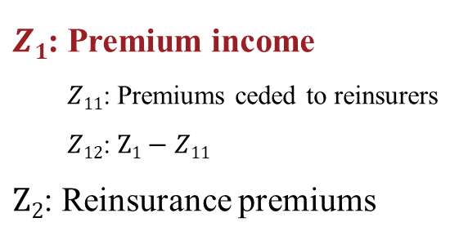
Network DEA in Insurance Industry
Multi-output network DEA model in Non-life Insurance Industry
Notations:
$X1$: Insurance expenses
$X2$: Operation expenses
$X21$: 50% of $X2$
$X22$: 50% of $X2$
$Z1$: Premium income
$Z11$: Premiums ceded to reinsurers
$Z12$: $Z1−Z11$
$Z2$: Reinsurance premiums
$P1$: Direct insurance
$P2$: Reinsurance
$P3$: Profit generation
$Y1$: Underwriting profit
$Y2$: Investment profit
$$X1$$
$$P1$$
$$Z1$$
$$Y1$$
$$Z12$$
$$X21$$
$$P3$$
$$Z11$$
$$X2$$
$$P2$$
$$Z2$$
$$Y2$$
$$X22$$

Slide 16

Network DEA in Insurance Industry
Multi-output network DEA model in Non-life Insurance Industry
Notations:
$X1$: Insurance expenses
$X2$: Operation expenses
$X21$: 50% of $X2$
$X22$: 50% of $X2$
$Z1$: Premium income
$Z11$: Premiums ceded to reinsurers
$Z12$: $Z1−Z11$
$Z2$: Reinsurance premiums
$Z1$: Premium income
$P1$: Direct insurance
$P2$: Reinsurance
$P3$: Profit generation
$Y1$: Underwriting profit
$Y2$: Investment profit
汽車保險
火災保險
貨物運輸保險
船體保險
漁船保險
航空保險
傷害保險
健康保險
工程保險
責任保險
信用保證保險
其他保險
$$X1$$
$$P1$$
$$Z1$$
$$Y1$$
$$Z12$$
$$X21$$
$$P3$$
$$Z11$$
$$X2$$
$$P2$$
$$Z2$$
$$Y2$$
$$X22$$

Slide 17
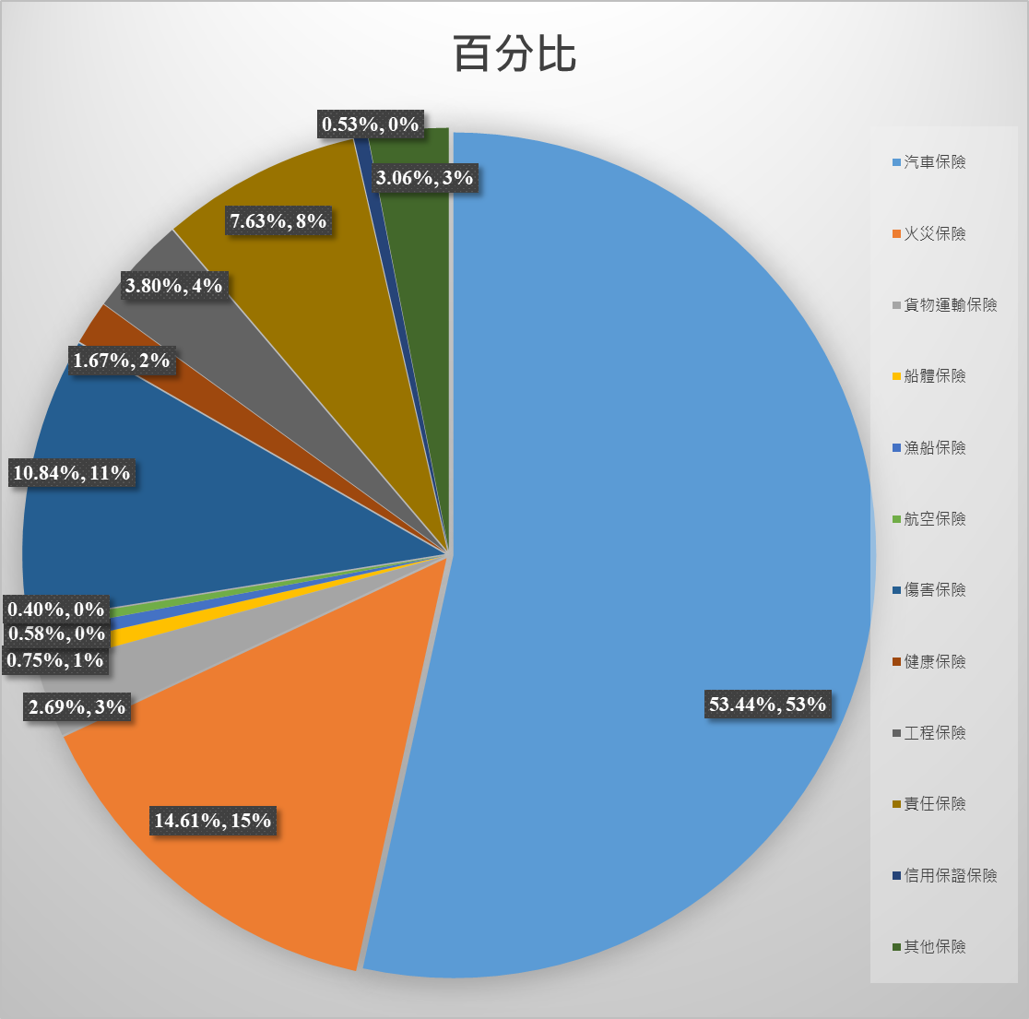

Network DEA in Insurance Industry
Multi-output network DEA model in Non-life Insurance Industry
Notations:
$X1$: Insurance expenses
$X2$: Operation expenses
$X21$: 50% of $X2$
$X22$: 50% of $X2$
$Z1$: Premium income
$Z11$: Premiums ceded to reinsurers
$Z12$: $Z1−Z11$
$Z2$: Reinsurance premiums
$Z1$: Premium income
$P1$: Direct insurance
$P2$: Reinsurance
$P3$: Profit generation
$Y1$: Underwriting profit
$Y2$: Investment profit
汽車保險
火災保險
貨物運輸保險
船體保險
漁船保險
航空保險
傷害保險
健康保險
工程保險
責任保險
信用保證保險
其他保險
$$X1$$
$$P1$$
$$Z1$$
$$Y1$$
$$Z12$$
$$X21$$
$$P3$$
$$Z11$$
$$X2$$
$$P2$$
$$Z2$$
$$Y2$$
$$X22$$

Slide 18
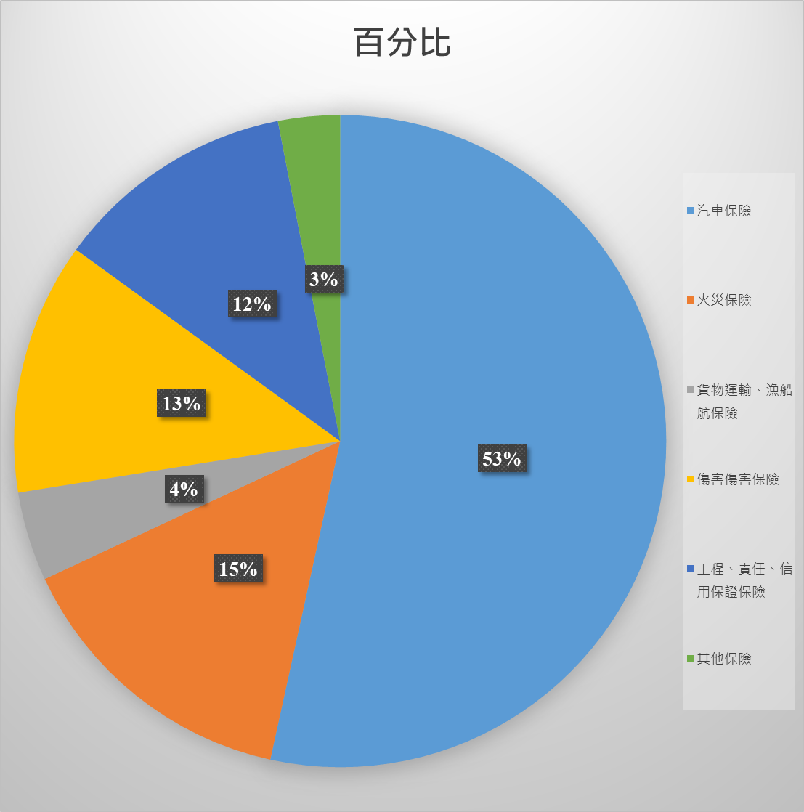
Network DEA in Insurance Industry
Multi-output network DEA model in Non-life Insurance Industry
Notations:
$X1$: Insurance expenses
$X2$: Operation expenses
$X21$: 50% of $X2$
$X22$: 50% of $X2$
$Z1$: Premium income
$Z11$: Premiums ceded to reinsurers
$Z12$: $Z1−Z11$
$Z2$: Reinsurance premiums
$Z1$: Premium income
$P1$: Direct insurance
$P2$: Reinsurance
$P3$: Profit generation
$Y1$: Underwriting profit
$Y2$: Investment profit
汽車保險
火災保險
貨物運輸保險
船體保險
漁船保險
航空保險
傷害保險
健康保險
工程保險
責任保險
信用保證保險
其他保險
$$X1$$
$$P1$$
$$Z1$$
$$Y1$$
$$Z12$$
$$X21$$
$$P3$$
$$Z11$$
$$X2$$
$$P2$$
$$Z2$$
$$Y2$$
$$X22$$

Slide 19
Network DEA model(according to Hwang and Kao 2008)
Revised network DEA model
Multi-output network DEA model in Non-life Insurance Industry
資料取得
資料視覺化

Slide 20
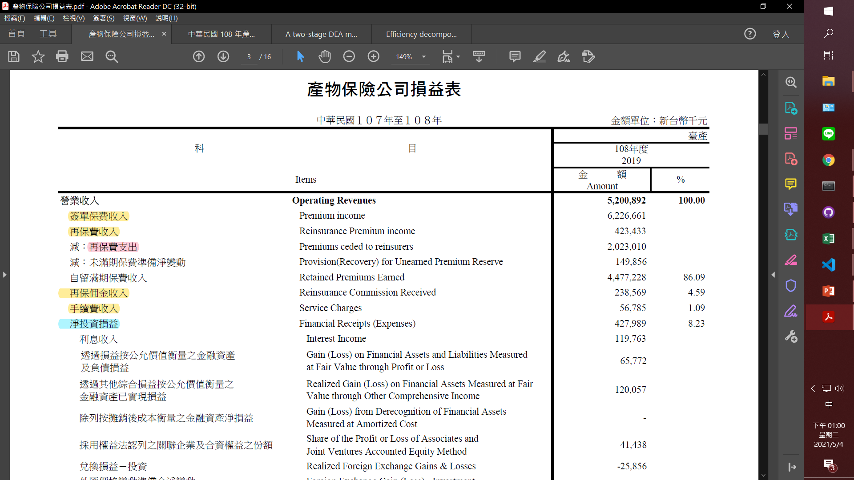
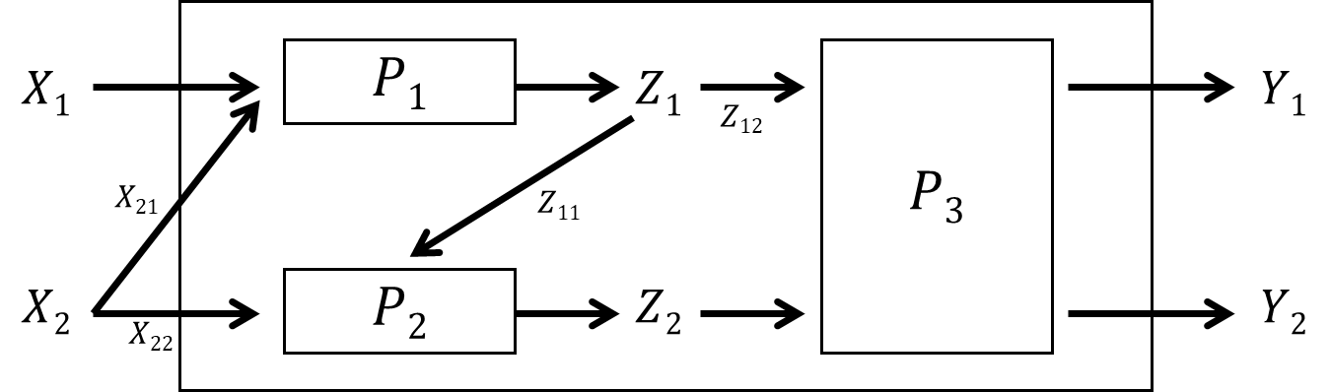
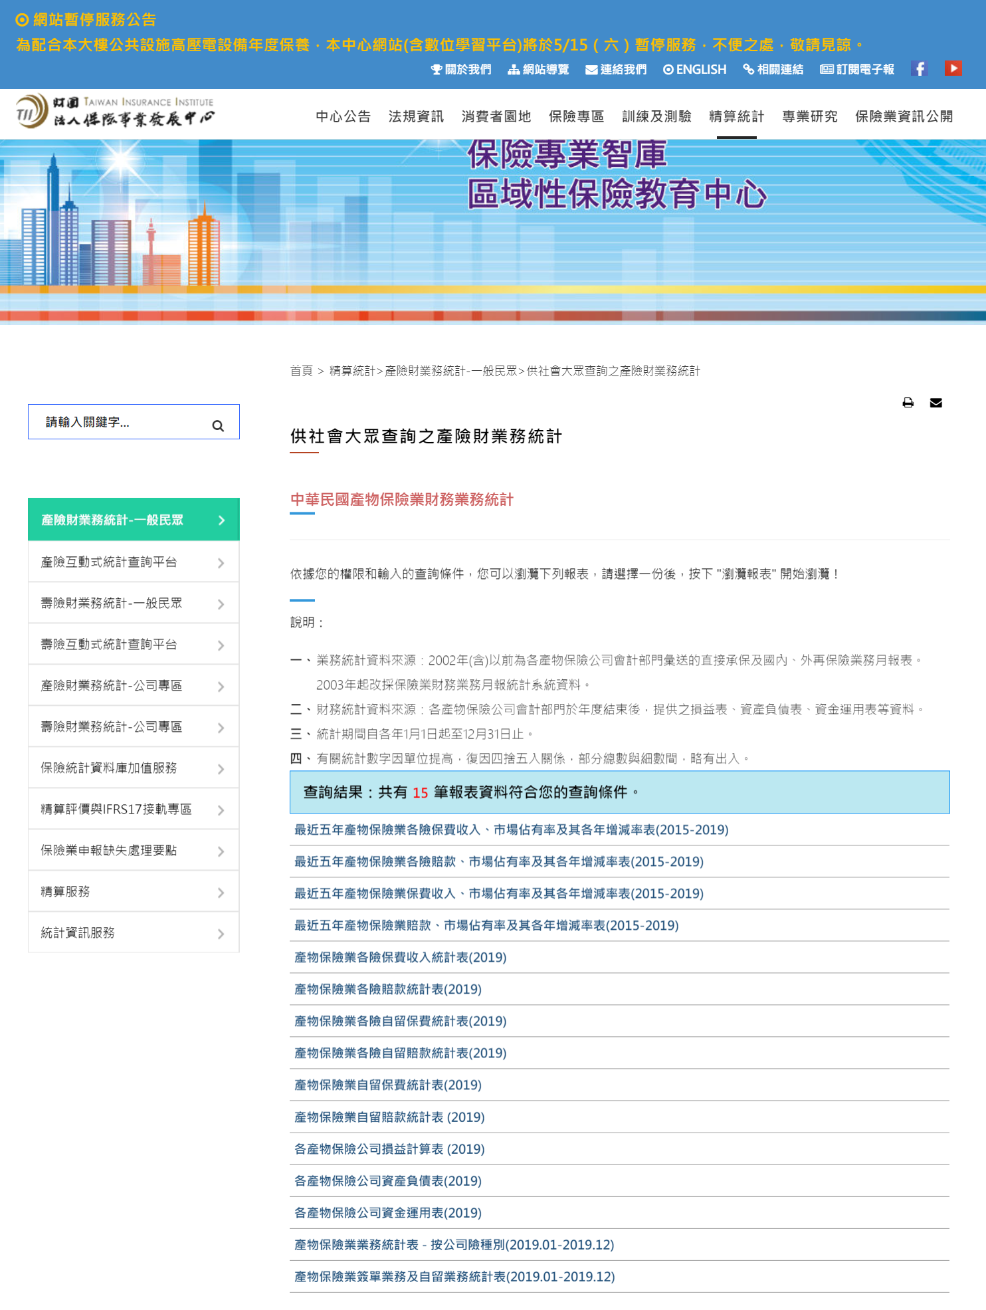
資料取得
Network DEA in Insurance Industry
https://www.tii.org.tw/tii/actuarial/actuarial1/report/result.html

Slide 21
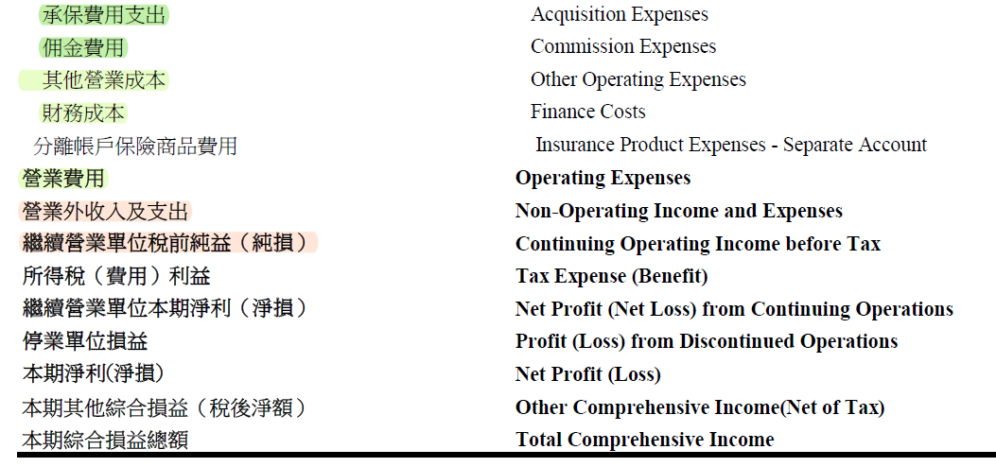
資料取得
Network DEA in Insurance Industry
https://www.tii.org.tw/tii/actuarial/actuarial1/report/result.html
Notes:
Y1 （> 0）解法 ：
把所有人加上一個固定值，不會影響績效排序，但是有可能有彼此的效率變得更接近（ORA）
法二：
另外跟老師要

Slide 22
Network DEA model(according to Hwang and Kao 2008)
Revised network DEA model
Multi-output network DEA model in Non-life Insurance Industry
資料取得
資料視覺化

Slide 23
資料視覺化
Network DEA in Insurance Industry
Notes:
(原始金額)算五個的 cosine similarity
要算誰跟誰的 portfolio 比較像（建好模型之後再做就好）
先用 CRS跑完再用vrs
可算 scale efficiency （crs/vrs）

Slide 24
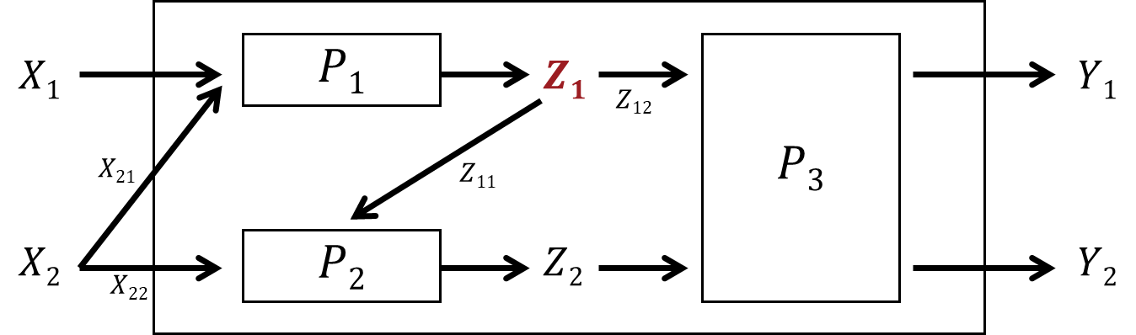


DMU 數量問題
Network DEA in Insurance Industry
https://www.tii.org.tw/tii/actuarial/actuarial1/report/result.html
國內產險家數：20
國內壽險家數：21
$Z1$: Premium income
$Z1$: Premium income
汽車保險
火災保險
貨物運輸保險
船體保險
漁船保險
航空保險
傷害保險
健康保險
工程保險
責任保險
信用保證保險
其他保險
個人人壽保險
個人傷害保險
個人健康保險
個人年金保險
團體人壽保險
團體傷害保險
團體健康保險
團體年金保險
其餘參數總計：5

